Slide 1
Market Singapore® New Products

Slide 2
Products and services drive our UnFranchise® Business. Everybody wants new products.
Every UnFranchise Owner must be a product of the product.
Every UnFranchise Owner must sell products and build share of customer.
Every UnFranchise Owner must take the responsibility of success.
Teams become champions when everyone shares the load.

Slide 3
I.M.P.A.C.T.
Selling
Makes Selling The Product Easy

Slide 4
Investigate

Slide 5
Meet

Slide 6
Probe

Slide 7
Apply

Slide 8
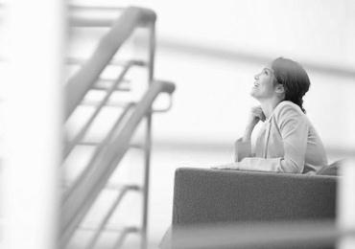
Convince

Slide 9
Tie-up

Slide 10
NEW PRODUCTS
for
Market Singapore 2017

Slide 11
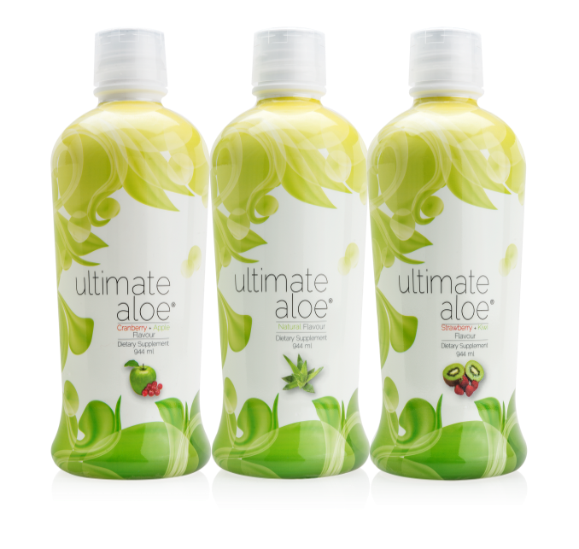
Ultimate Aloe® Juice
Code:
SG1280 – Natural Flavour
SG1282 – Cranberry Apple Flavour
SG1285 – Strawberry Kiwi Flavour
UC: S$31.00
SR: S$43.50
BV: 14

Slide 12
The Market
The population of 5.6 million, of which, more than 4 million qualify
Anyone looking to improve digestive health
Anyone looking to strengthen their immune system
Health conscious individuals

Slide 13
Ultimate Aloe® Juice Benefits
Supports good digestive health
Supports immune health
Meets or exceed the International Aloe Science Council Standards for Aloe Purity and Content
More than 200 nutrients
Essential vitamins and minerals
Essential amino acids (20 of 22, 9 essential)
Essential fatty acids

Slide 14
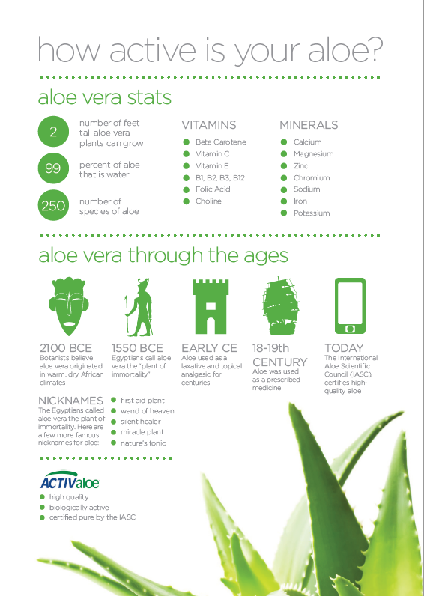

Slide 15
Ultimate Aloe® Juice
Code:
SG1280 – Natural Flavour
SG1282 – Cranberry Apple Flavour
SG1285 – Strawberry Kiwi Flavour
UC: S$31.00
SR: S$43.50
BV: 14

Slide 16
Market Singapore® New Products

Slide 17
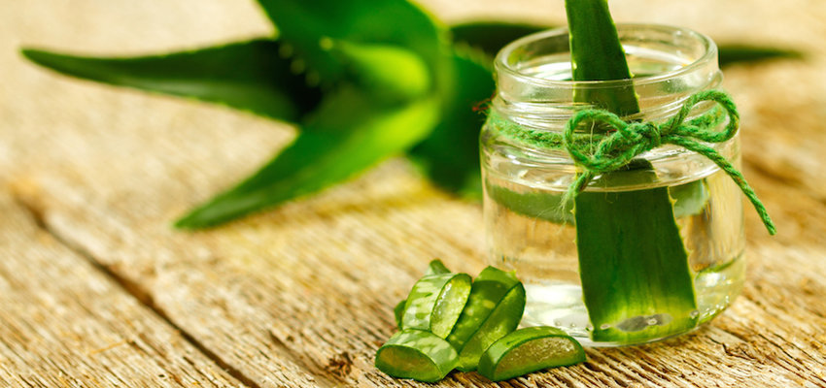
Wonders of Aloe Vera
Used for centuries across different civilizations:
Sumeria, Egypt, China, India, Mesopotamia

Slide 18
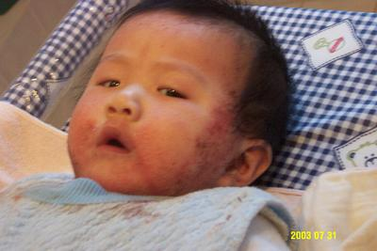
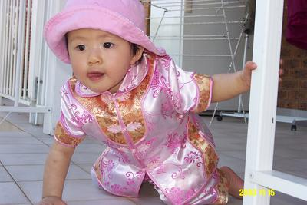
Sharing Stories
This is a personal testimonial. Market Singapore has not evaluated such testimonials.

Slide 19
Detox and Fasting
Skin Appearance
Insect bites
This is a personal testimonial. Market Singapore has not evaluated such testimonials.
Notes:
Used for Detox and Fasting
Helps in all Skin Conditions – gums, jellyfish bites, burns, cuts, bruises, ulcers, boils, sore throats, mouth ulcers, eczema, pimples, radiation burns
* Spider and insect bites
Improves Skin Appearance – used for many skin care products and lotions

Slide 20
Natural Food Preservative
Anti-fungal properties
This is a personal testimonial. Market Singapore has not evaluated such testimonials.
Notes:
Aids in maintenance of normal blood sugar levels
Acts as Natural Food Preservative
Enhances Vitamin Bioavailability
Lowers High Cholesterol and Triglycerides
Has anti-inflammatory and anti-fungal properties

Slide 21
Digestive Health
*Food poisoning*
Helps eye conditions
*conjunctivitis*
This is a personal testimonial. Market Singapore has not evaluated such testimonials.
Notes:
Halts Inflammation of Joints – arthritis pain
Promotes Digestive Health – acid reflux, constipation, diarrhea, IBS, Crohn’s Disease
Food poisoning
Helps with eye conditions – itchiness, cornea tumor, conjunctivitis
Functions as nature’s own “sports drink” for electrolyte balance

Slide 22
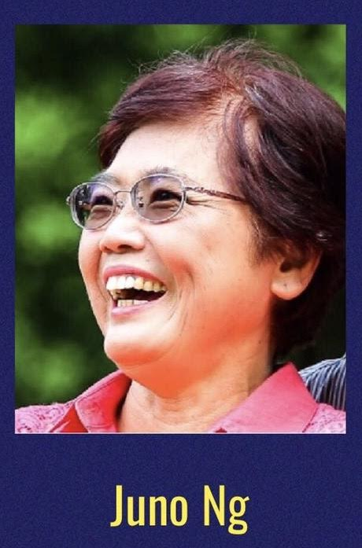
Champion of Ultimate Aloe Vera
This is a personal testimonial. Market Singapore has not evaluated such testimonials.

Slide 23
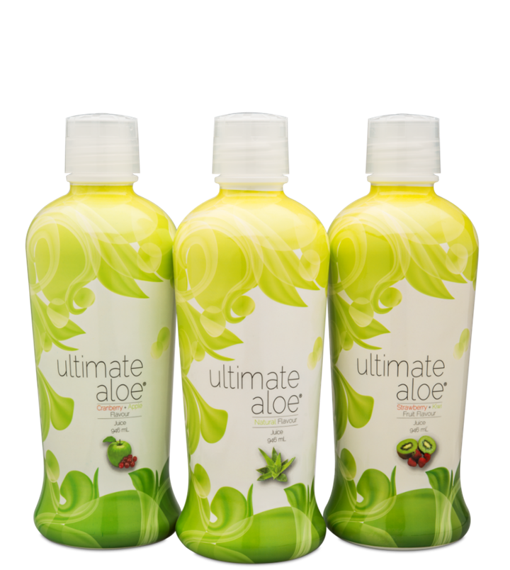
It’s finally here in Singapore!
Feel the Difference
with

Slide 24
is...
the customisable
weight management programme!

Slide 25
Low Glycaemic Impact Eating
Body Composition / Metabolism
Weight Management Supplements
Education

Slide 26
TLS™ Journal
Code: SG6561
UC: S$18.00
SR: S$25.00
Download TLS Health Guide at sg.tlsSlim.com > Resources > Programme Downloads

Slide 27
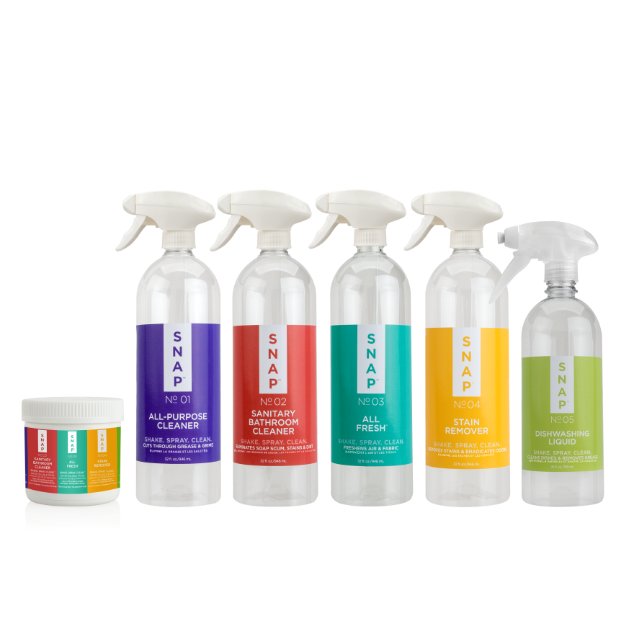
SNAP™ Essentials Kit
Code: SG6945
UC: S$49.75
SR: S$69.75
BV: 20

Slide 28
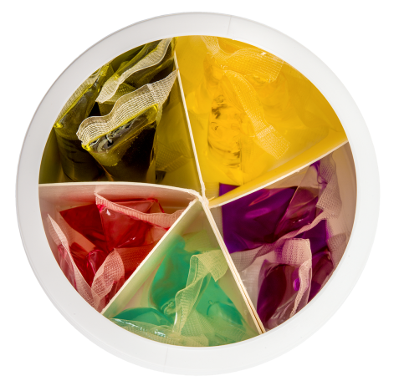
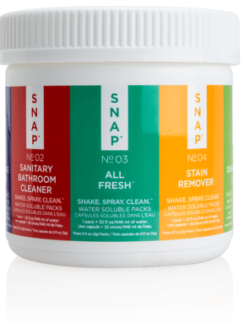
SNAP™ Essentials Kit
Snap
All-Purpose Cleaner
Sanitary Bathroom Cleaner
Dishwashing Liquid with Foam Dispenser
All-Fresh
Stain Remover

Slide 29
The Market
5.6 million people
Everyone with a house, office place of business
People looking to save space
People looking to save money
ONLY S$4.65 per bottle

Slide 30
Snap™ Essentials Kit Benefits
Phosphate Free
Non Toxic
Biodegradable
IT WORKS!!!

Slide 31
Snap™ Essentials Kit DEMONSTRATION

Slide 32
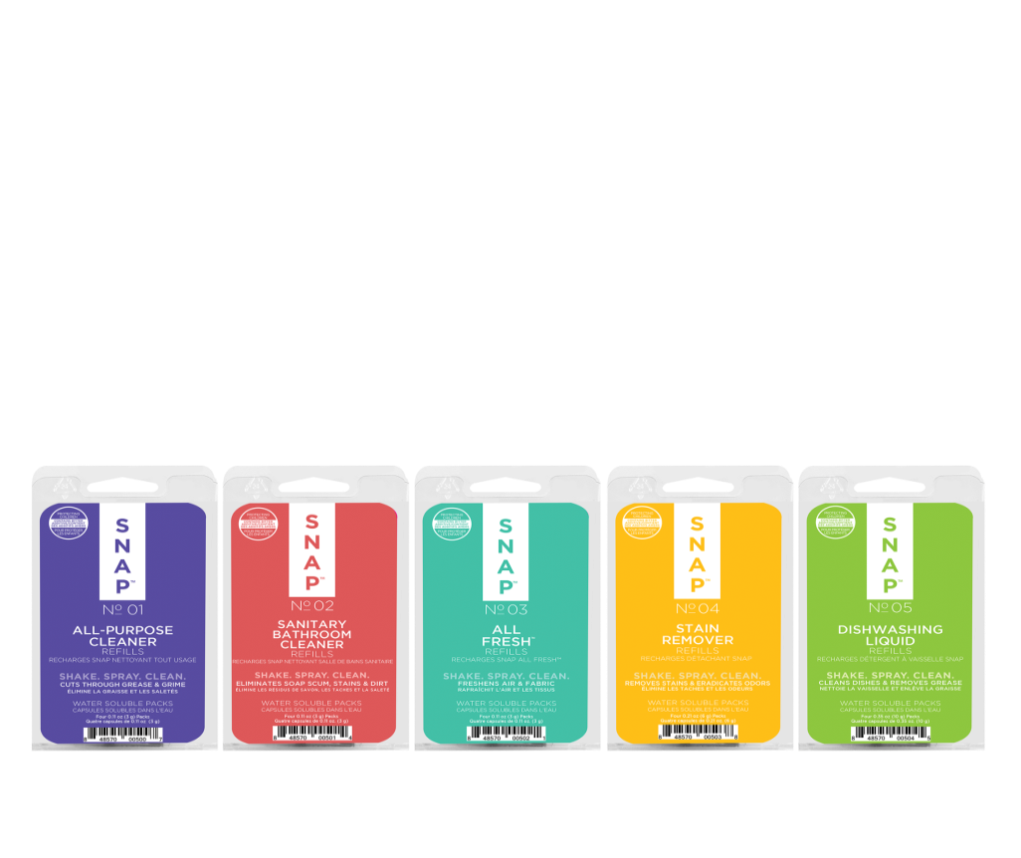
SNAP™ Essentials Refills
COMING
SOON
Codes:
SG6915 – All-Purpose Cleaner
SG6916 – Sanitary Bathroom Cleaner
SG6917 –Dishwashing Liquid
SG6918 – All Fresh
SG6919 – Stain Remover
UC: S$13.00
SR: S$18.25
BV: 4.5

Slide 33
Market Singapore® New Products

